Slide 1
Organizing our Arguments
with Toulmin’s Structure

Slide 2
What is LOGIC?
Logic is the study of the principles of correct reasoning.
Our goal is to construct arguments that are as logical and well-reasoned as possible – but this is often easier said than done!

Slide 3
Old-School Logic: The Syllogism
Since the time of Aristotle, students have been taught that the “syllogism” is the most important, if not the only, path to truth.
A syllogism derives a conclusion from a set of conditions (called premises) which are thought to be true and which share a common term.

Slide 4
Syllogisms
Example SYLLOGISM:
Major Premise: All men are mortal.
Minor Premise: Socrates is a man.
Conclusion: Socrates is a mortal.
Syllogisms are like “IF-THEN” statements in math:
IF all men are mortal AND Socrates is a man, THEN Socrates [must be] a mortal.

Slide 5
Why Syllogisms aren’t always useful in arguments…
In most subjects (with the exceptions of math and science), and in most everyday situations and disputes, we do not have premises that we know to be absolutely true.
Instead, we have to deal with statements/conditions/premises that we believe are probably true – but not absolutely true.
In the past two or three decades, colleges have turned to a newer way of dealing with logic: The Toulmin Method.
The Toulmin Method is ideal for situations that are not “black and white” – situations in which the premises/conditions are debatable.

Slide 6
The Toulmin Method of Argument
Toulmin’s basic understanding of argument includes several elements:
A claim
Grounds that state the reason for the claim
Qualifications that identify possible exceptions to the claim
Based on evidence of some sort
A warrant that explains how the evidence supports the claim
Backing supporting the warrants
Rebuttals/counterarguments that refute opposing claims.

Slide 7
Toulmin Method: The CLAIM
“What statement is the author defending?”
The claim is the central thesis or opinion that the author attempts to prove through the citation of reasons, facts, evidence, and examples.
Sometimes the claim may contain qualifiers or exceptions (explained later).

Slide 8
Toulmin Method: QUALIFIERS
“How is the claim limited (or qualified)?”
A qualifier is a word that LIMITS the claim in some way (examples: sometimes, often, in some cases, usually, generally, under these circumstances, etc.).
The qualifier gives the author some “wiggle room” by letting the audience know that there are possible exceptions to the claim.
It’s usually unwise to make an absolute claim; use a qualifier!

Slide 9
Toulmin Method: The GROUNDS
Grounds are the “because” statements that back up your argument.
Example:
Violent video games should be carefully monitored because these games cause addiction and psychological harm.
The GROUNDS of this claim are:
These games cause addiction
These games cause psychological harm

Slide 10
Toulmin Method: EVIDENCE
“What kinds of evidence (data, anecdotes, case studies, citations from experts, etc.) are offered as support for the claim?”
Evidence must be GOOD – i.e., sufficient, accurate, and credible.
Evidence must be RELEVANT – it must actually prove the claim.
Generally, successful arguments require a good balance of ethos, pathos, and logos.

Slide 11
Practice with Evidence
Each claim is followed by possible evidence. Decide whether each piece of evidence is RELEVANT or not – i.e., whether the evidence truly PROVES the claim.
CLAIM: Selling cigarettes ought to be against the law.
1. Cigarette smoking kills more people than all illegal drugs combined.
2. Nonsmokers are endangered by breathing the smoke from others’ cigarettes.
3. Alcohol is another legal drug that kills numerous Americans every year.
Correct Answers: #1 and #2
#3 is not relevant because it does not directly address and prove the claim!

Slide 12
Practice with Evidence
Read the following paragraph and identify which sentence does NOT support the claim with relevant evidence.
Getting rid of eyesores in the neighborhood does more than simply beautify; it can improve the economic and social life of an area. [CLAIM] Not long ago, a neighborhood in Philly decided to improve its appearance by planting a community garden. [1] As a result, neighbors spent more time together outdoors. [2] Thus, graffiti writers were discouraged from frequenting the area. [3] Additional police also keep the streets safer. [4] Finally, the cleaner streets and safer atmosphere also attracted more customers to local businesses. [5]
Correct Answer: Sentence #4 does NOT prove the claim!
#4 is not relevant because police presence is not part of the original claim, so this info does not relate to the claim.

Slide 13
Toulmin Method: The WARRANT
Warrants may simply be common sense rules that people accept as generally true, laws, scientific principles, and thoughtfully argued definitions.
The warrant is the foundation upon which your entire argument is built.
Weak warrant = Weak argument ☹

Slide 14
Toulmin Method: The WARRANT (cont.)
This is a WEAK warrant:
Grounds
Because homework stresses me out
Claim
High schools should not assign homework
Warrant
Things that stress me out should be abolished.
WHY WEAK?
Not “universal” enough; too limited
Not likely to be generally accepted by the audience

Slide 15
Toulmin Method: The WARRANT (cont.)
This is a STRONG warrant:
Claim
Driving hybrid cars are an effective way to reduce pollution
Grounds
Because cars are the biggest source of privately-produced pollution
Warrant
Cars generally have a long life-span, so the decision to switch to a hybrid car will have a long-term impact on pollution levels.
WHY STRONG?
Universal idea that will be generally accepted by the audience
Reasonable, based on fact/truth

Slide 16
Toulmin Method: BACKING
Backing is support or evidence that proves the warrant.
Some warrants will require very little backing, such as the example below:
Warrant: The kind thing to do is help people when they’re in need.
Backing: Helping others is a virtue that has been taught for ages. OR Americans find value in helping others.
If the warrant isn’t controversial, it likely will not require extensive backing.

Slide 17
Toulmin Method: BACKING (cont.)
Some warrants will need to be proved to the audience. (Warrant: The U.S. government has the responsibility to protect its citizens’ health.
Backing: The Constitution grants the government the right to “promote the general welfare.”
The more controversial the warrant, the more solid evidence you will need to provide to back it up.

Slide 18
Toulmin Method: REBUTTALS/COUNTERARGUMENTS
Since real-world arguments are based on probability instead of absolute fact, there are likely to be counterarguments (opposing claims).
Writers must try to anticipate potential objections to the claim and explain why these counterarguments do not undermine or destroy the claim. This is called the REBUTTAL.

Slide 19
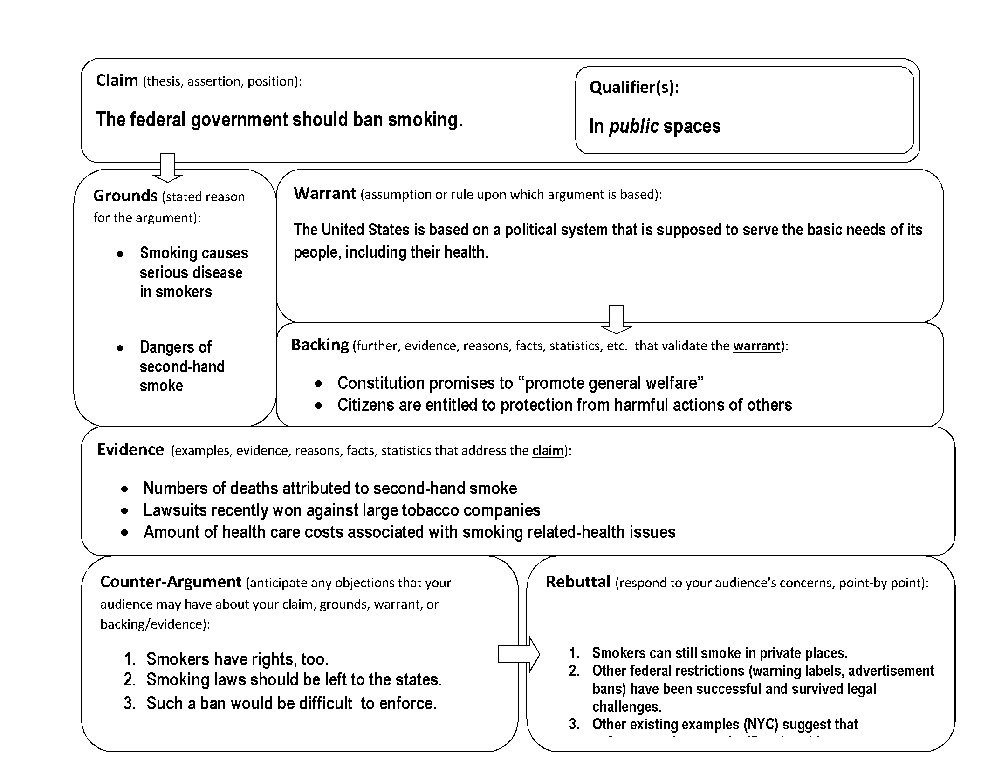
Example Toulmin Structure

